Slide 1


EDA on Hotel Booking Dataset
Presented by :- Zohaib Sheikh

Slide 2
Problem Statement
In this project we will be analyzing Hotel Booking data. This data set contains booking information for a city hotel and a resort hotel, and includes information such as when the booking was made, length of stay, the number of adults, children, and/or babies, and the number of available parking spaces.
Hotel industry is a very volatile industry and the bookings depends on above factors and many more.
The main objective behind this project is to explore and analyze data to discover important factors that govern the bookings and give insights to hotel management, which can perform various campaigns to boost the business and performance

Slide 3
BUSINESS CONTEXT
In the highly competitive hotel industry, it is crucial for hotels to maximize revenue and occupancy rates by understanding demand patterns, customer behavior, and booking trends. Analyzing the hotel booking dataset which can provide valuable insights and assist in making data-driven decisions to optimize revenue management and enhance the overall customer experience. Develop data-driven strategies and improve operational efficiency.

Slide 4
KNOWING ABOUT THE DATASET
This dataset is a dataset from hotel industry, and I have to analyze the Booking pattern,
customer behavior and uncover operational inefficiency , and the insight behind it.
This dataset contains 1,19,390 rows and 32 columns.
There are 4, 488, 16340, 112593 values missing in children, country, agent and company
columns respectively .
There are 31,994 duplicate rows in the dataset.

Slide 5
Understanding Variables
hotel :Hotel (Resort Hotel or City Hotel)
Is canceled :Value indicating if the booking was canceled (1) or not (0)
Lead time :Number of days that elapsed between the date of booking and the arrival date
Arrival date year :Year of arrival date
Arrival date month :Month of arrival date
Arrival date week number :Week number of year for arrival date
Arrival date day of month :Day of arrival date
Stays in weekend nights :Number of weekend nights (Saturday or Sunday) the guest stayed or booked to stay at the hotel
Stays in week nights :Number of week nights (Monday to Friday) the guest stayed or booked to stay at the hotel

Slide 6
Understanding Variables
adults :Number of adults
children :Number of children
babies :Number of babies
meal :Type of meal booked. Categories are presented in standard hospitality meal packages: BB, FB, HB, SC
country :Country of origin. Categories are represented in the ISO 3155–3:2013 format
Market segment :Market segment designation. In categories, the term “TA” means “Travel Agents” and “TO” means “Tour Operators”
Distribution channel :Booking distribution channel. The term “TA” means “Travel Agents” and “TO” means “Tour Operators”
Is repeated guest :Value indicating if the booking name was from a repeated guest (1) or not (0)
Previous cancellation :Number of previous bookings that were cancelled by the customer prior to the current booking
Previous bookings not cancelled :Number of previous bookings not cancelled by the customer prior to the current booking

Slide 7
Understanding Variables
Reserved room type :Code of room type reserved
Assigned room type :Code for the type of room assigned to the booking.
Booking changes :Number of changes/amendments made to the booking from the moment the booking was entered on the PMS.
Deposit type :Indication on if the customer made a deposit to guarantee the booking
agent :ID of the travel agency that made the booking
company :ID of the company/entity that made the booking or responsible for paying the booking.
Days in waiting list :Number of days the booking was in the waiting list before it was confirmed to the customer
Customer type :Type of booking
ADR :Average Daily Rate
Required car parking spaces :Number of car parking spaces required by the customer
Total of special requests :Number of special requests made by the customer
Reservation status :Reservation last status
Reservation status date :Date at which the last status was set which the last status was set.

Slide 8
Cleaning the Data
180 dummy rows were removed because ,In that rows zero guests are present i.e. 0 adults + 0 children + 0 babies. We should remove those rows.
31,994 duplicates rows were removed .
Some imputation were done like replace Undefined meal type to SC, Undefined distribution channel to Direct, undefined market segment to Direct.
After cleaning now 87,230 rows is left.
Feature Engineering
New Columns added
​ Total night = weekday nights + weekend nights
Total people = adults + children (because these are payable)
​ Revenue = ADR * Total night

Slide 9
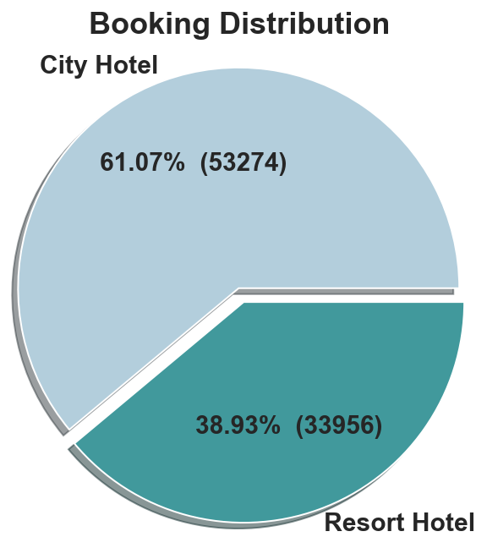
Booking Distribution
This Is Overall Booking Distribution.
City Hotel is Busiest hotel as compare to Resort Hotel.

Slide 10
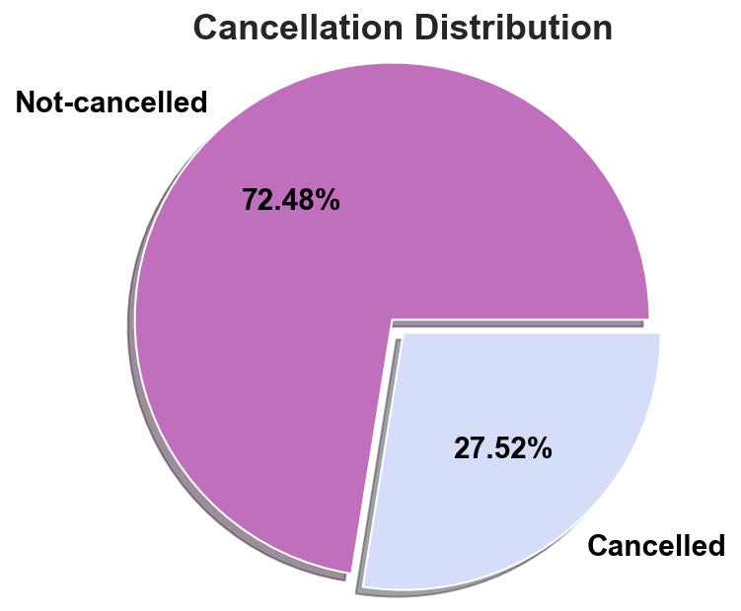
Cancellation Distribution
From All booking 27.52% Bookings were Cancelled.

Slide 11
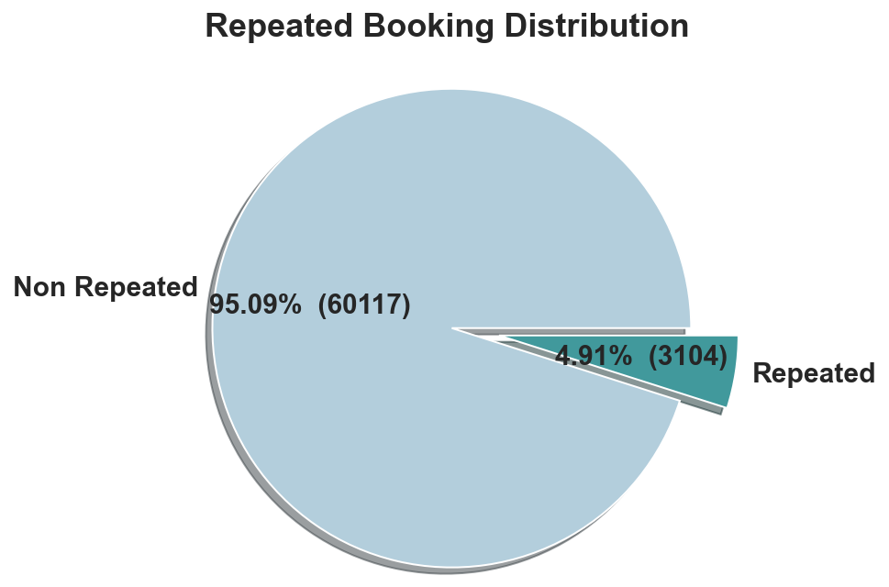
Repeated Booking
Only 4.91% people were revisited the hotel .Rest 95.09% were new guests. Thus retention rate is low.

Slide 12
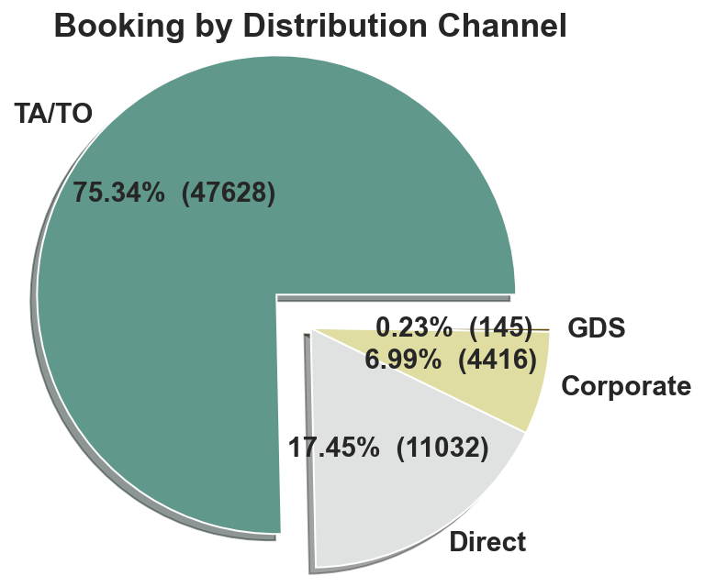
Booking by Distribution Channel
Most of the Bookings were done by Tour agent/Tour operator.
17.45% Booking fulfill Directly.
6.99% Booking were fulfill by Corporate.
Group Booking are rare.

Slide 13
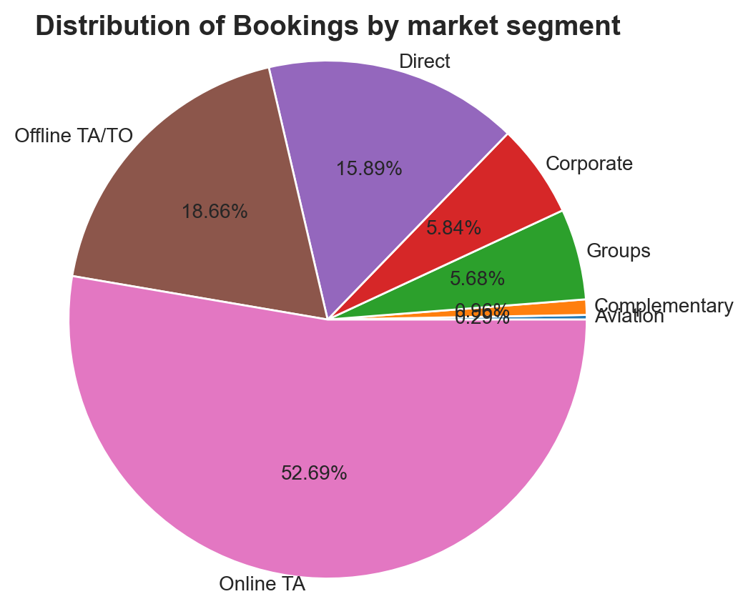
Booking Distribution by Market segment
Most of Booking came from Travel Agent / Tour Operator.

Slide 14
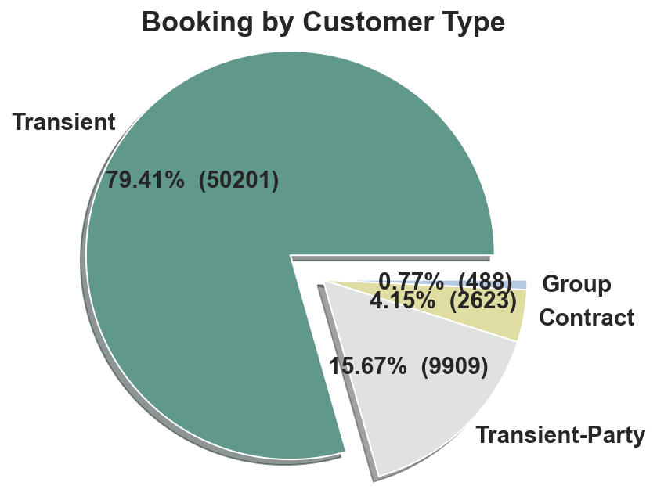
Booking by Customer Type
Most of Customer/guests were Transient type 79.41% .
And Transient-Party were 15.67% and 4.15% belong to Contract type. Reaming guests belong to groups.

Slide 15
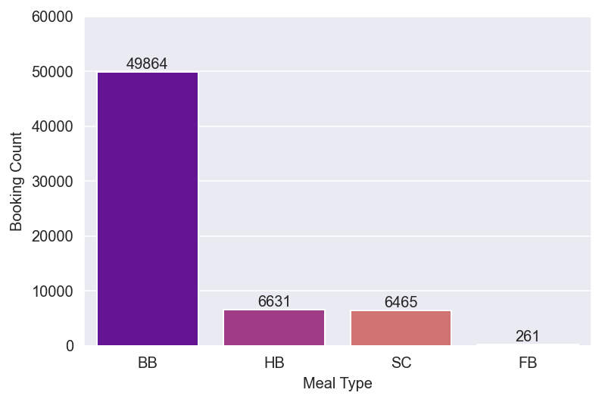
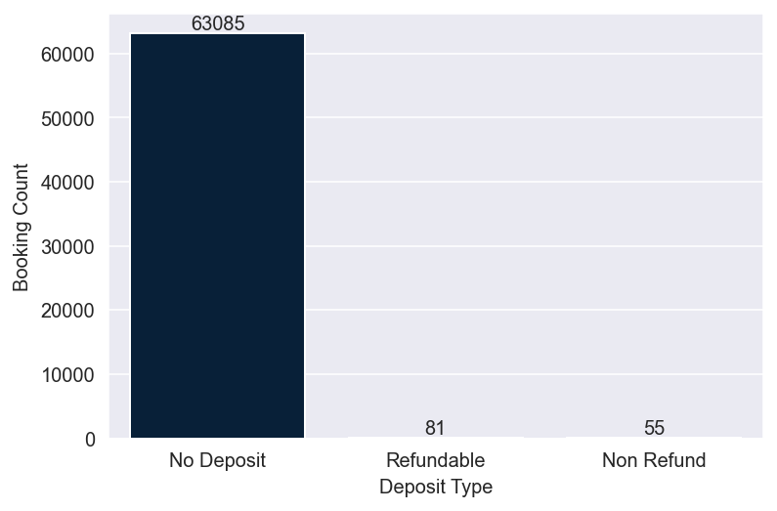
Meal Type and Deposit Type Booking Distribution
Bookings by Meal Type
Most of customers choose the meal type category as BB(Bed and Breakfast) that too around all the customers choose the no deposit type.
This shows the customer behavior that the customers wants to make a booking but they don’t want to pay in advance.
Booking by Deposit Type

Slide 16
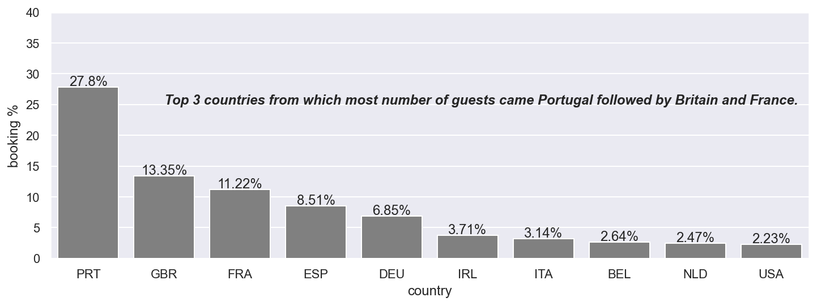
Top 10 countries by Bookings

Slide 17
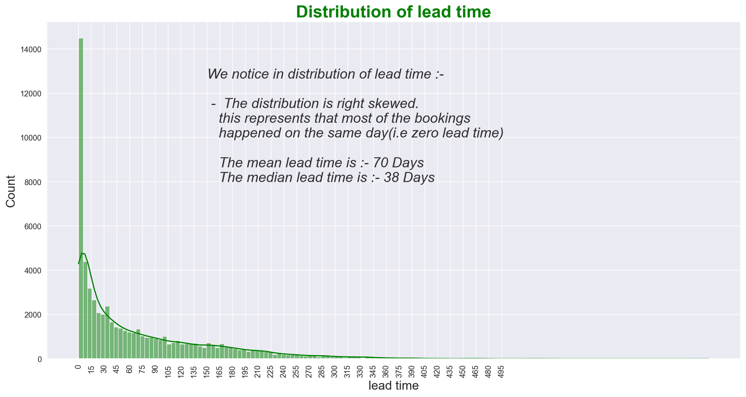
Lead time Distribution

Slide 18
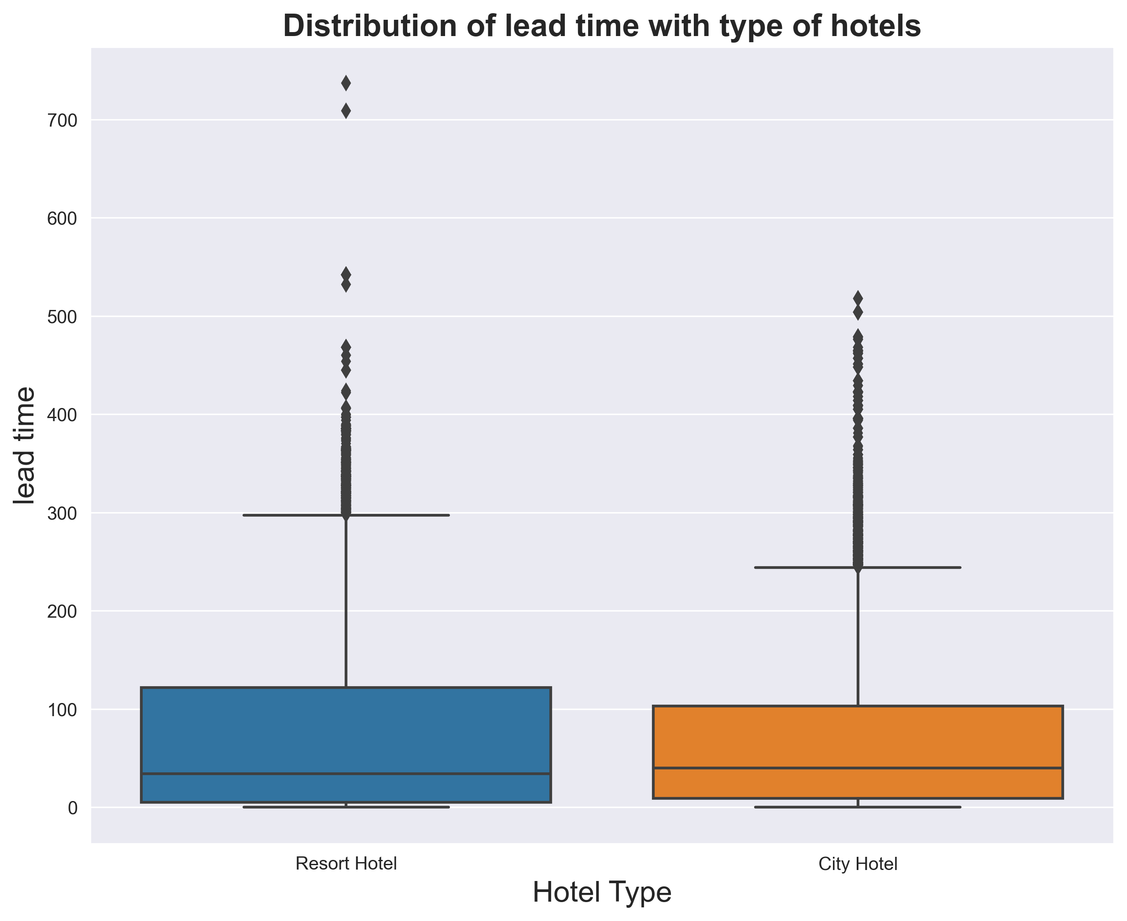
Distribution of Lead time by Hotel type
Around 50% population for both the hotels does booking in around 30 days advance but in resort hotel we can see lead time spread is more, showing that the resort hotel bookings are made in more advance than the city hotel.

Slide 19
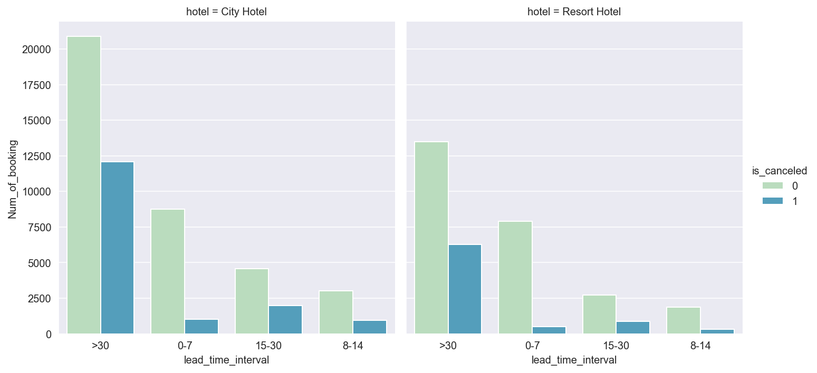
Cancellation by lead time
Most successful booking having lead time less than equal to 7 days for Both hotel .
Both Hotel faces great cancellation which have lead time greater than 30 days.

Slide 20
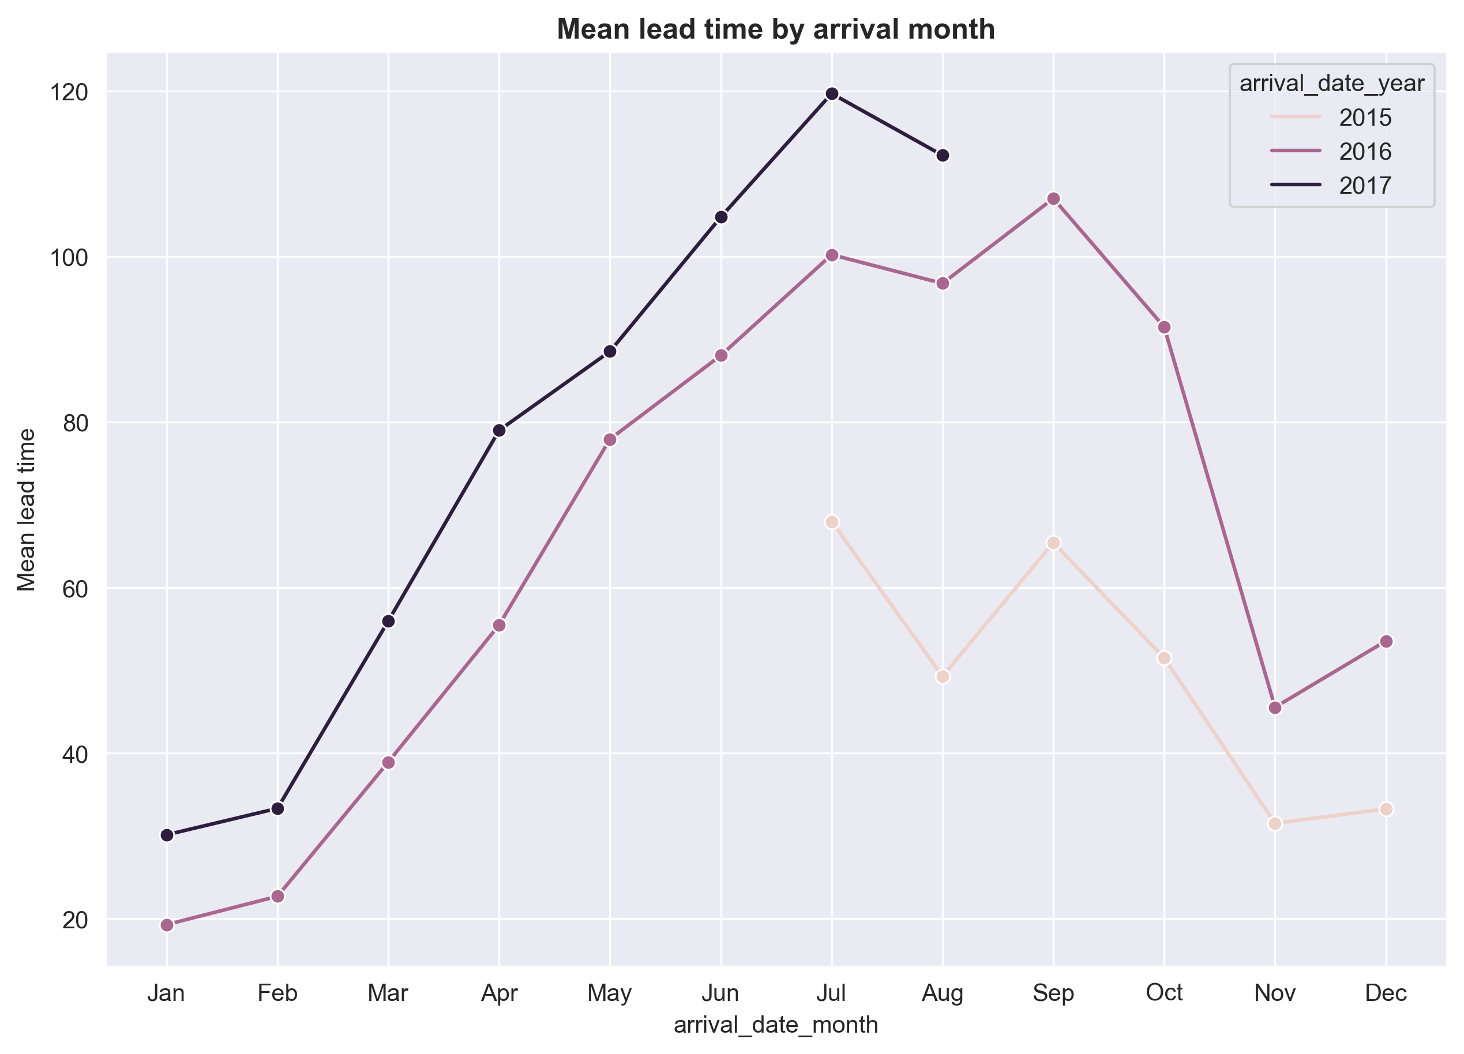
Monthly lead time by Arrival Month
It can be observed that customers arriving in the months of June, July, August, and September tend to make advance bookings of 2 to 3 months. This pattern suggests that these months may be the peak season, leading customers to secure their reservations well in advance.

Slide 21
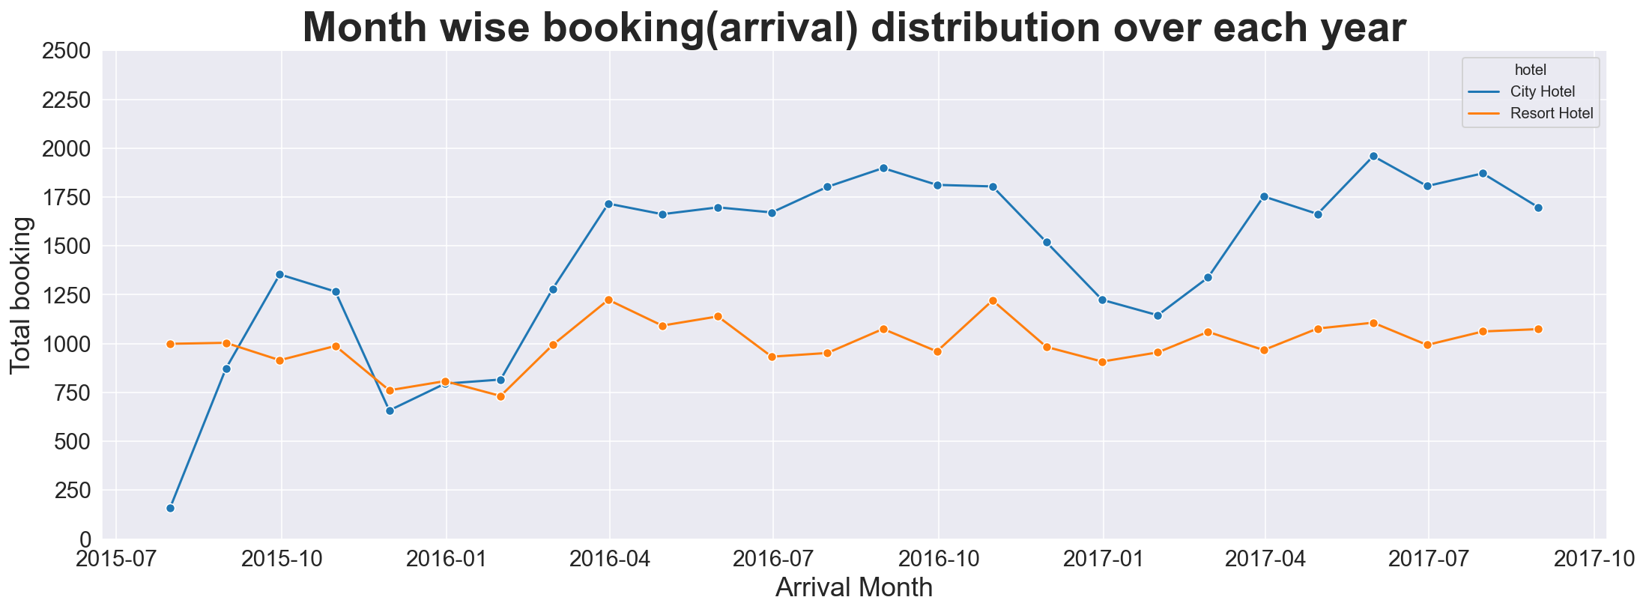
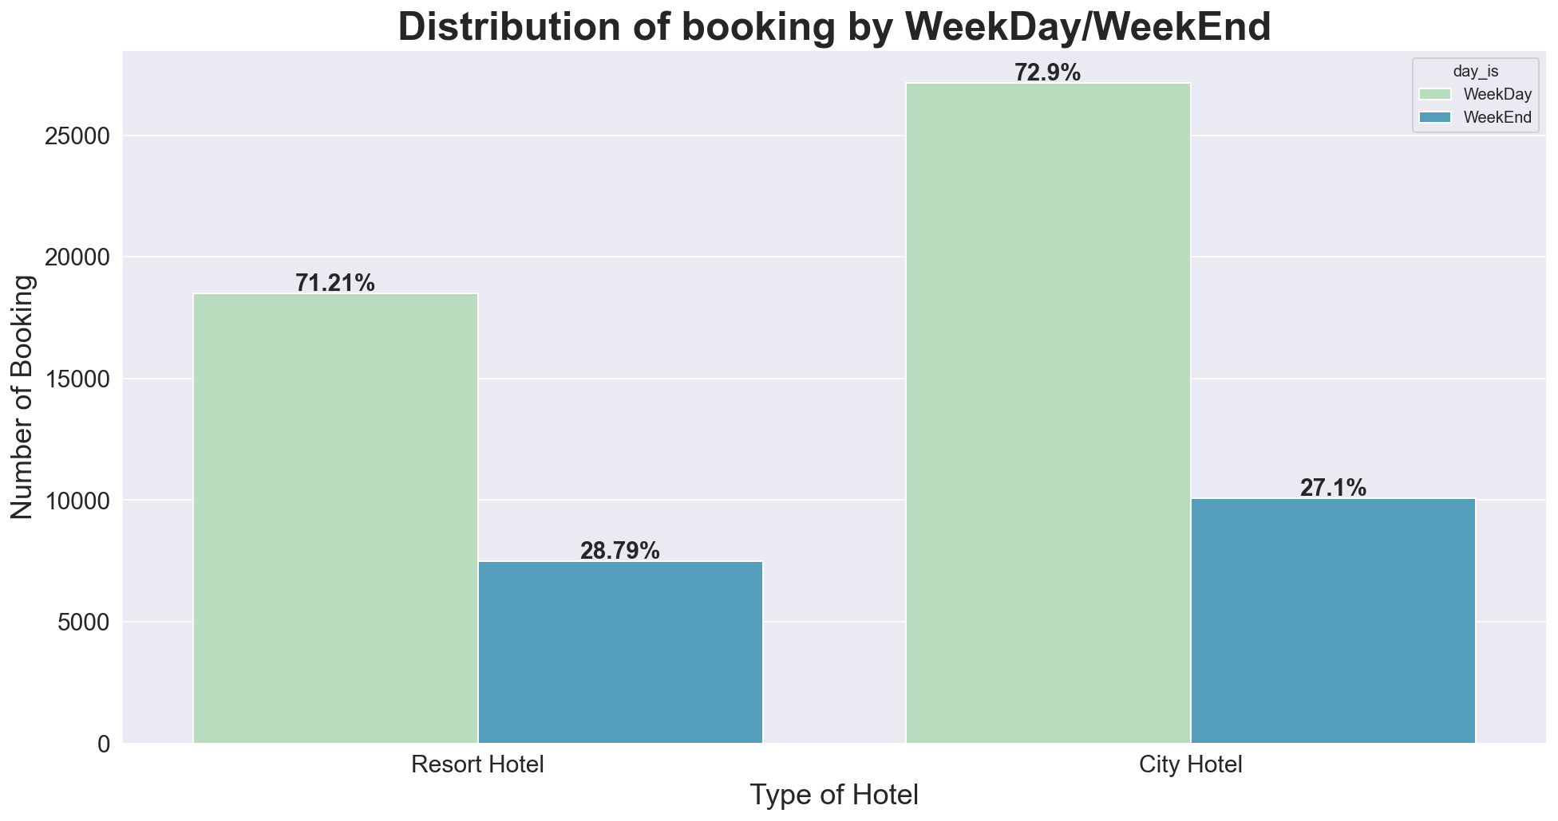
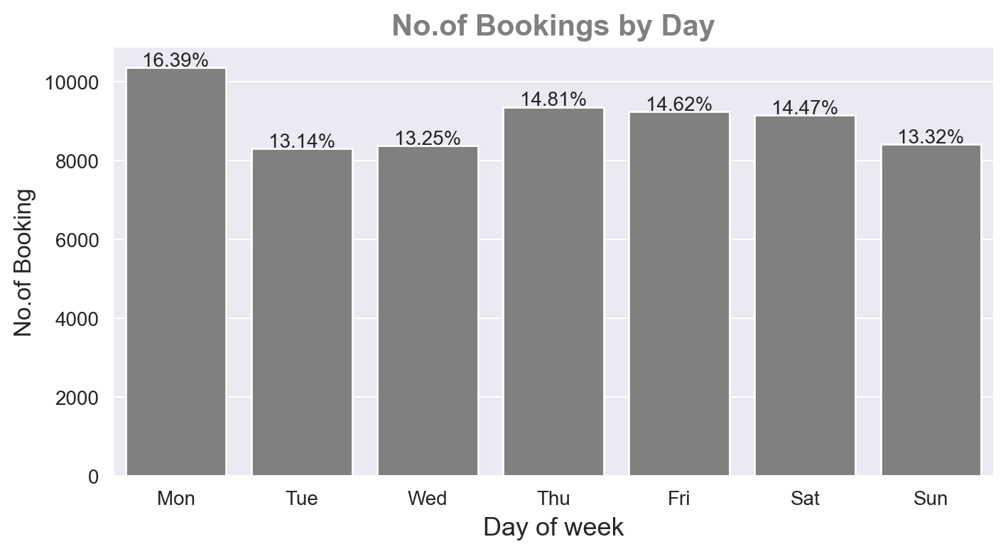
From the above plot we can clearly see the seasonal pattern where July, august, September seems to have a greater bookings over all the three years, which we also saw in the mean lead time booking where customers books around 2-3 months in advance for these peak months, showing the high demand months and other months where average lead time was seen shorter and here also we saw a decrease in bookings for those months. Thus showing trend for the low demand season.
That too the weekday bookings are higher than the weekend bookings.
Further looking into the bookings by day we got to know that the weekday bookings are high as the number of bookings are high on Mondays.
From which we can make an assumption that there are more people who are on business trips.

Slide 22
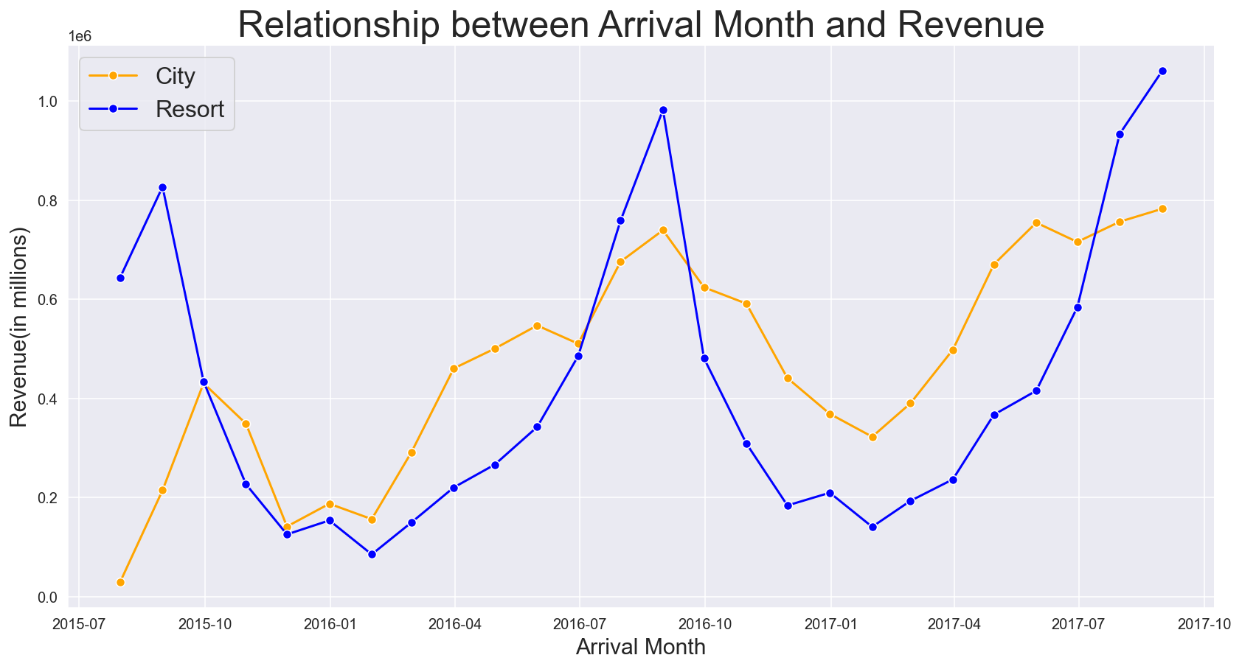
Relationship B/W Arrival month and Revenue
The revenue exhibits a pronounced upward trend, particularly in the months of July, August, and September. These months correspond to the peak demand period, during which a substantial number of bookings are made, resulting in increased revenue for the hotel.
Despite the city hotel having a higher number of bookings, the resort hotel generated more revenue during the peak months. This indicates that although the city hotel experienced a larger volume of bookings, the resort hotel's bookings in the peak months resulted in higher revenue generation.

Slide 23
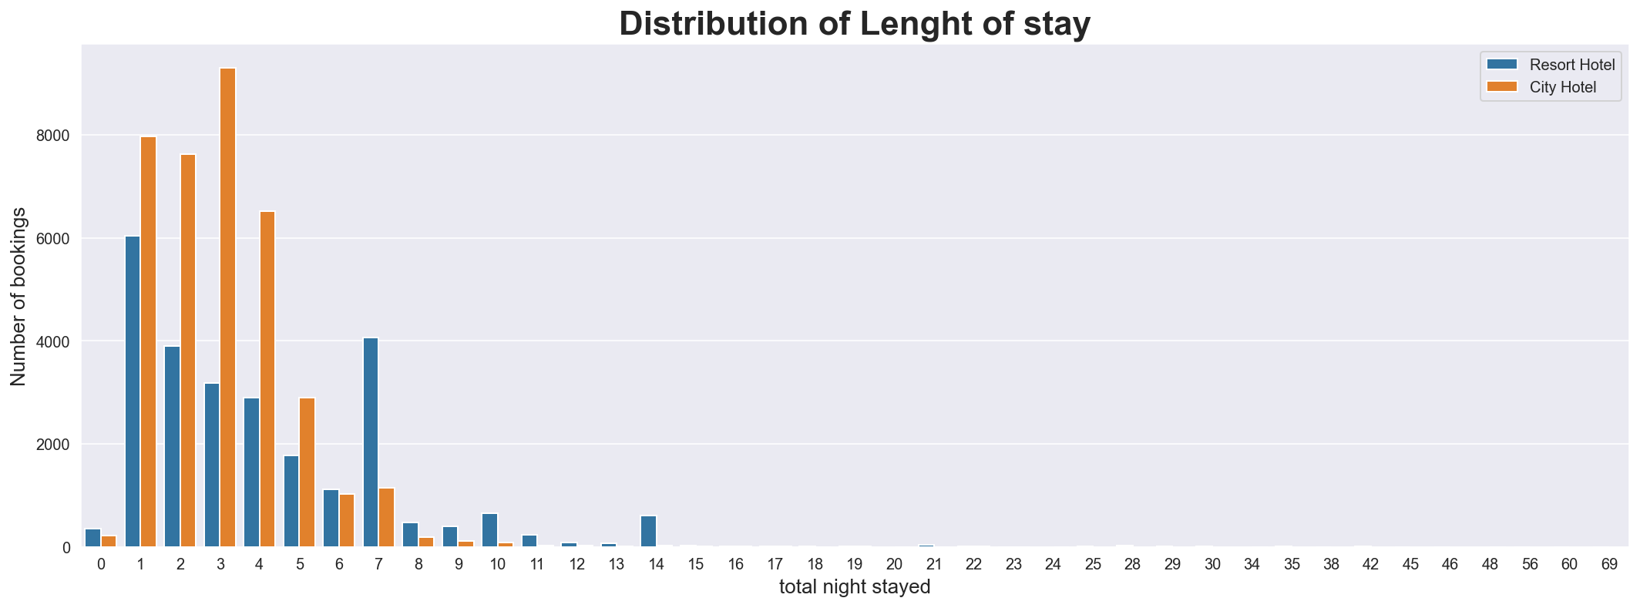
Distribution of length of stay
Most people stay for approximately 2-3 days at city hotels, whereas a distinct pattern emerges for resort hotels, with most guests staying for 7 days. It is evident that a significant number of bookings at the resort hotel extend up to 14 days, which contrasts with the shorter durations observed at the city hotel.

Slide 24
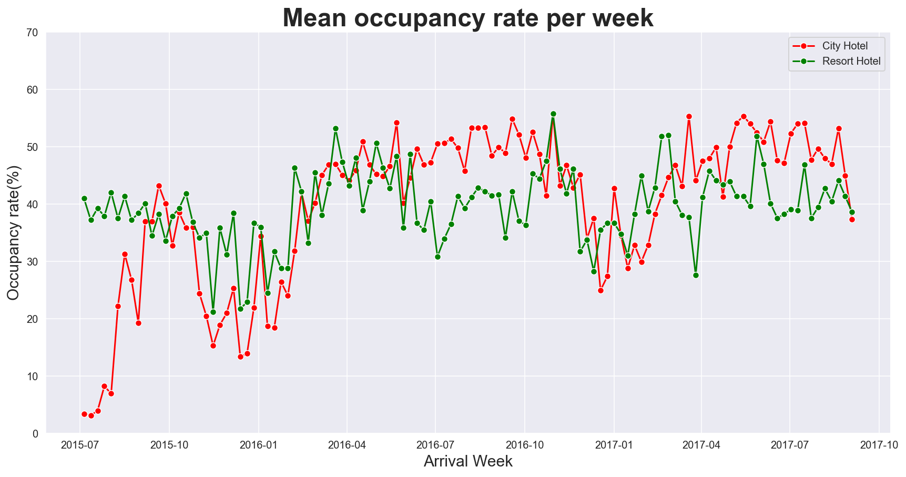
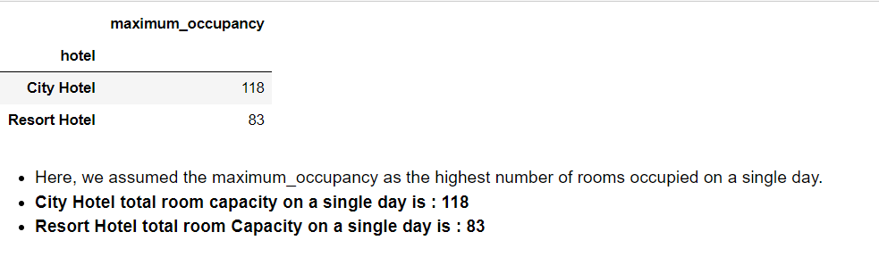
Weekly mean occupancy rate
The weekly average occupancy rate for both hotels remained consistently below 60% throughout all three years. Although there may have been individual days with maximum occupancy, the overall average occupancy rate on a weekly basis did not surpass 60%.

Slide 25
Cancellation Analysis
Compare
1.Hotel type: Compare the cancellation rates between the two types to identify any significant differences.
Group
2. Lead time: Group the bookings into different lead time intervals, such as less than 7 days, 7-14 days, 14-30 days, and so on.
Calculate
Calculate cancellation rates for each interval.
Analyze
3.Deposit type: Analyze whether the type of deposit made by guests has an impact on cancellation behavior.
Identify
4.Market segment: Identify if certain market segments have significantly different cancellation rates compared to others.
Analyze
5.Previous cancellations: Analyze whether guests with a history of cancellations are more likely to cancel future bookings.
Analyze
6.Booking changes: Analyze whether guests who make more changes to their bookings are more likely to cancel.
Analyze
7.Room types: Analyze whether guests tend to cancel more when the reserved and assigned room types differ.
Analyze
8. ADR : impact on ADR by cancellation

Slide 26
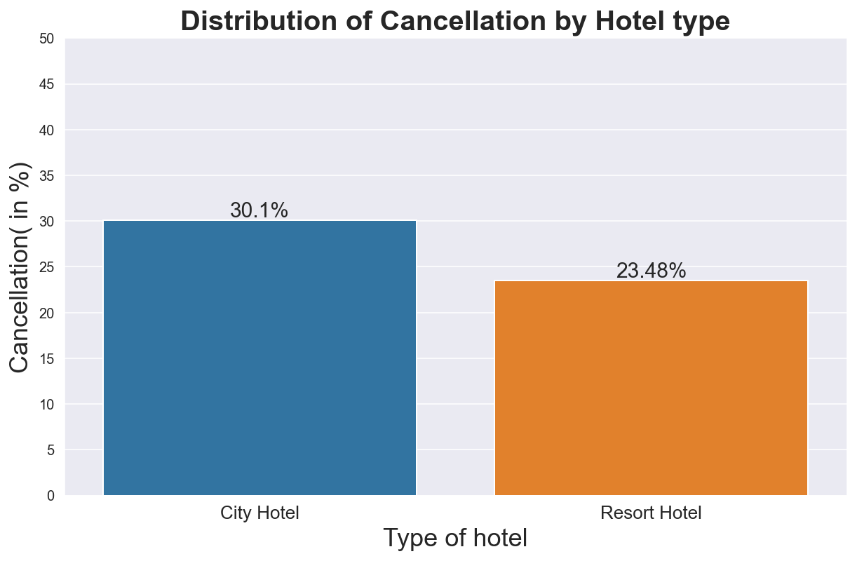
Cancellation by Hotel type
Overall City Hotel faces more Cancellation as compare to Resort Hotel.

Slide 27
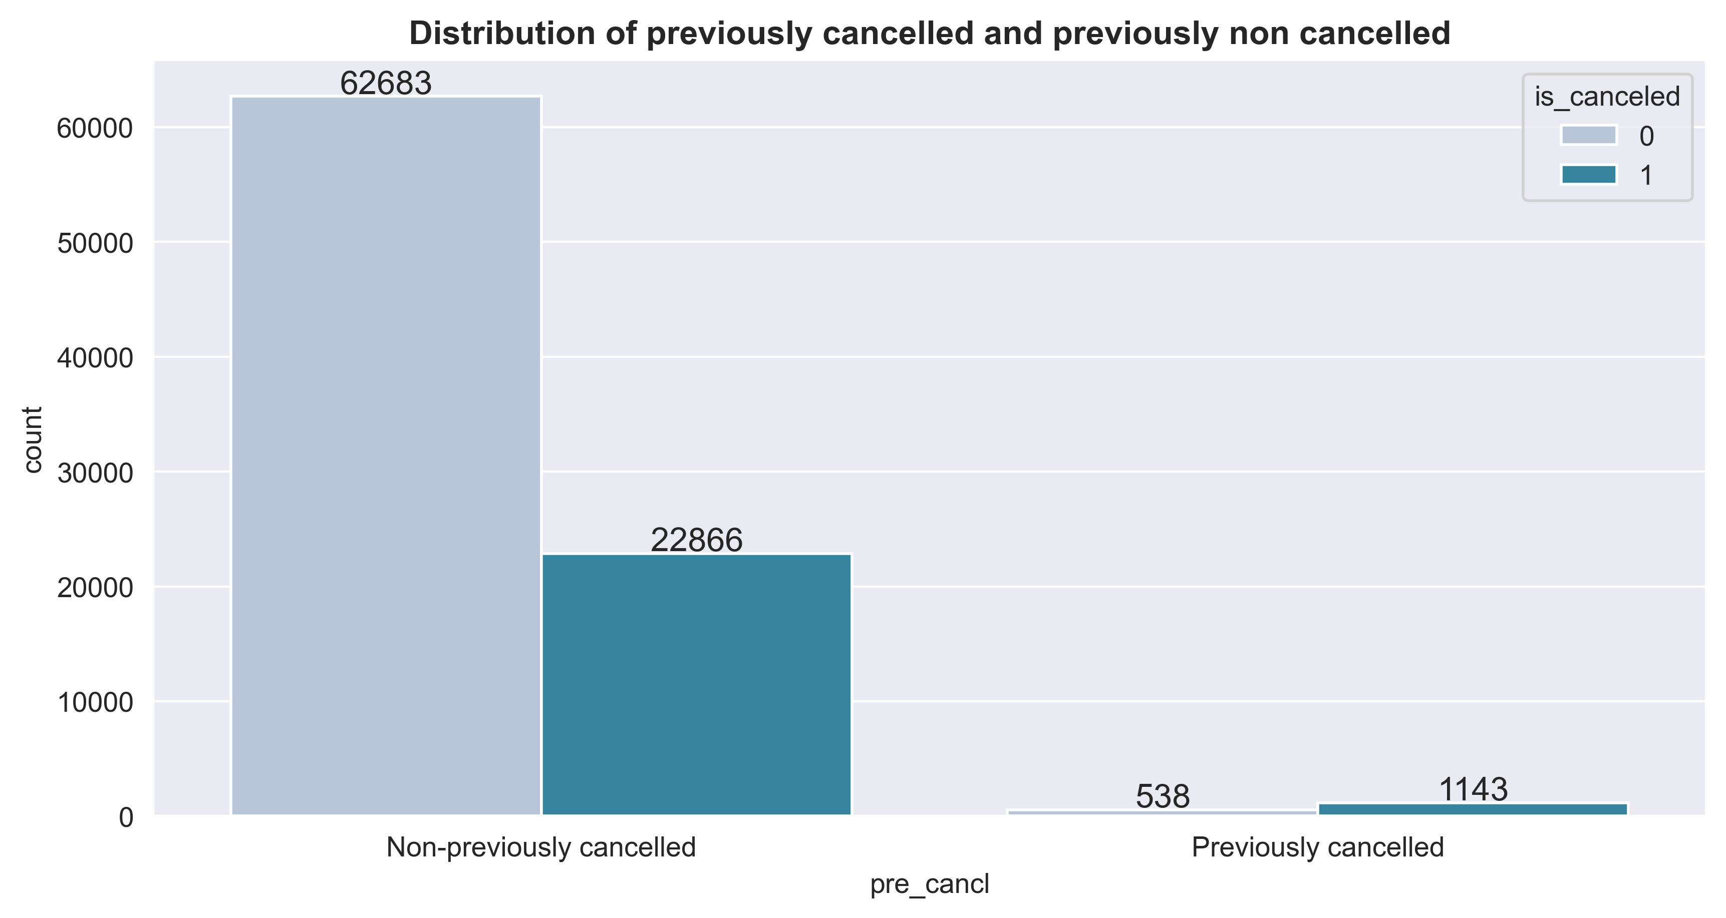
Relationship B/w Cancellation and Previous Cancellation
Based on this chart, there is a strong possibility that if a person has previously cancelled a booking, they will be more likely to cancel future bookings as well.

Slide 28
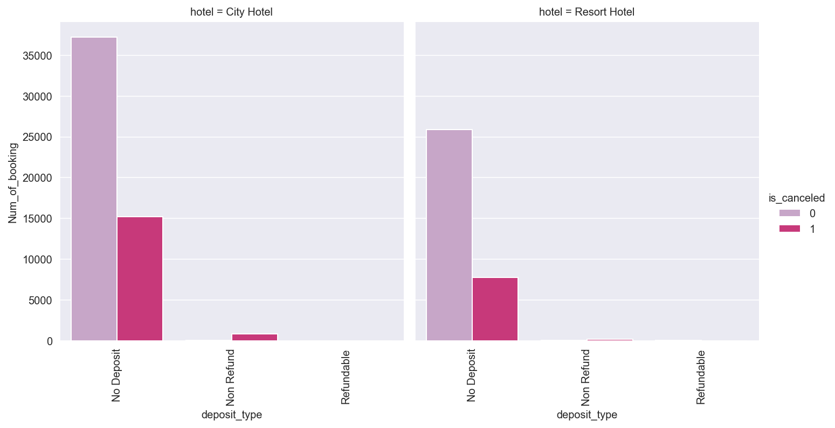
Cancellation by Deposit type
Despite the majority of guests preferring the No Deposit option, cancellations can still occur even when the deposit type is Non-Refundable. Therefore, it can be concluded that the deposit type does not significantly affect the occurrence of cancellations.

Slide 29
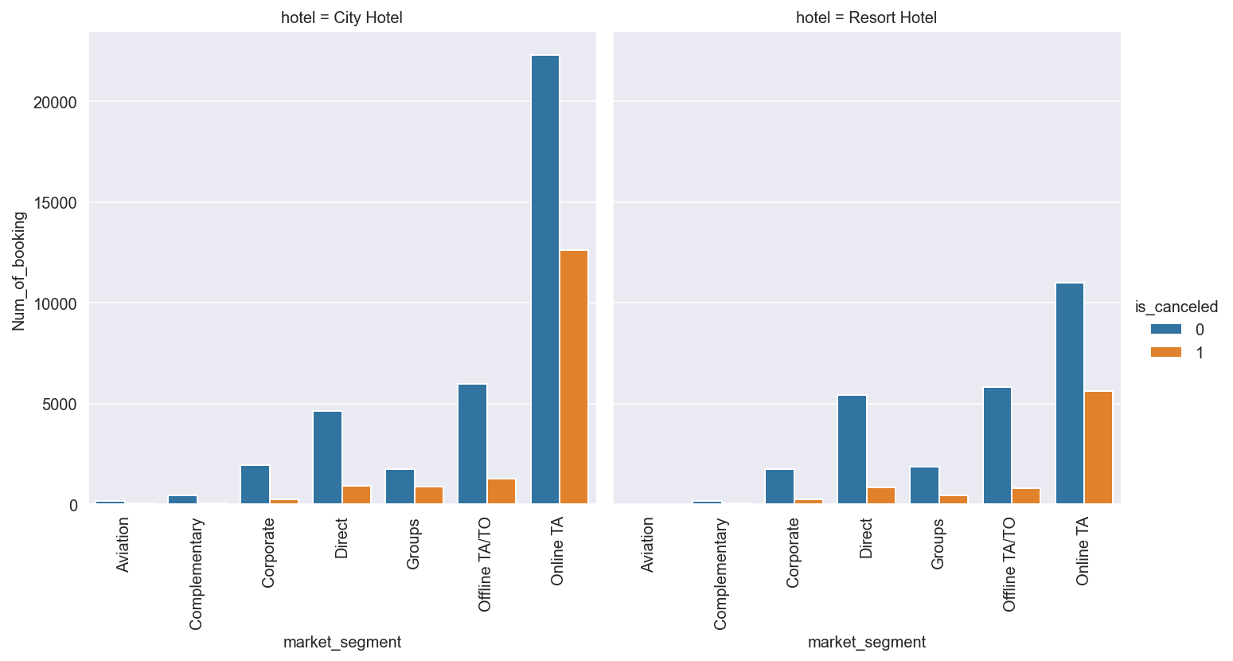
Cancellation by Market segment
Most successful booking rate is from Corporate followed by Direct and offline Travel Agent/Tour operator.
Online TA has least successful booking rate. But most of the booking came from this segment.

Slide 30
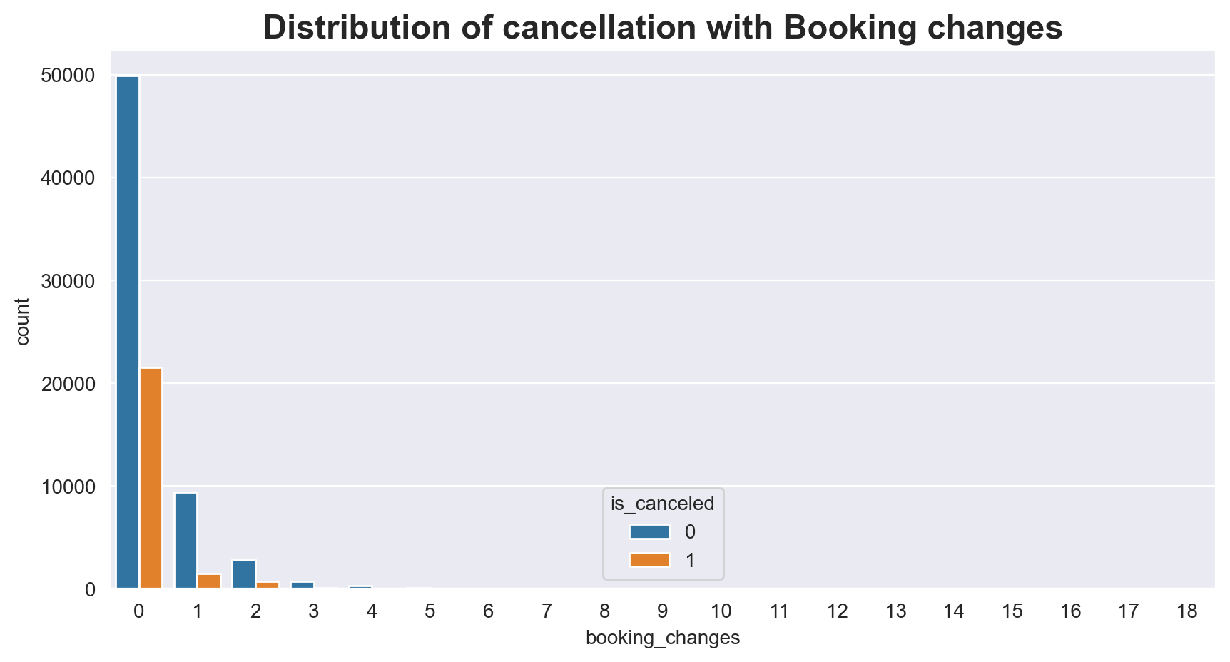
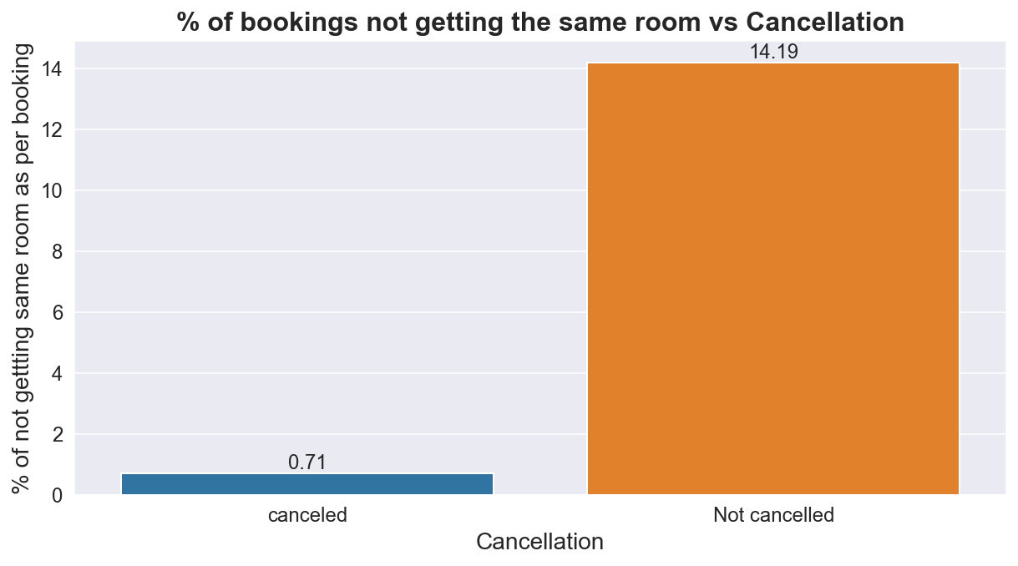
Cancellation by getting Different room & Booking change
. No significant cancellation found after any booking change and even after getting different room as compare to reserved room.
. This means, these factors do not affect cancellation of bookings

Slide 31
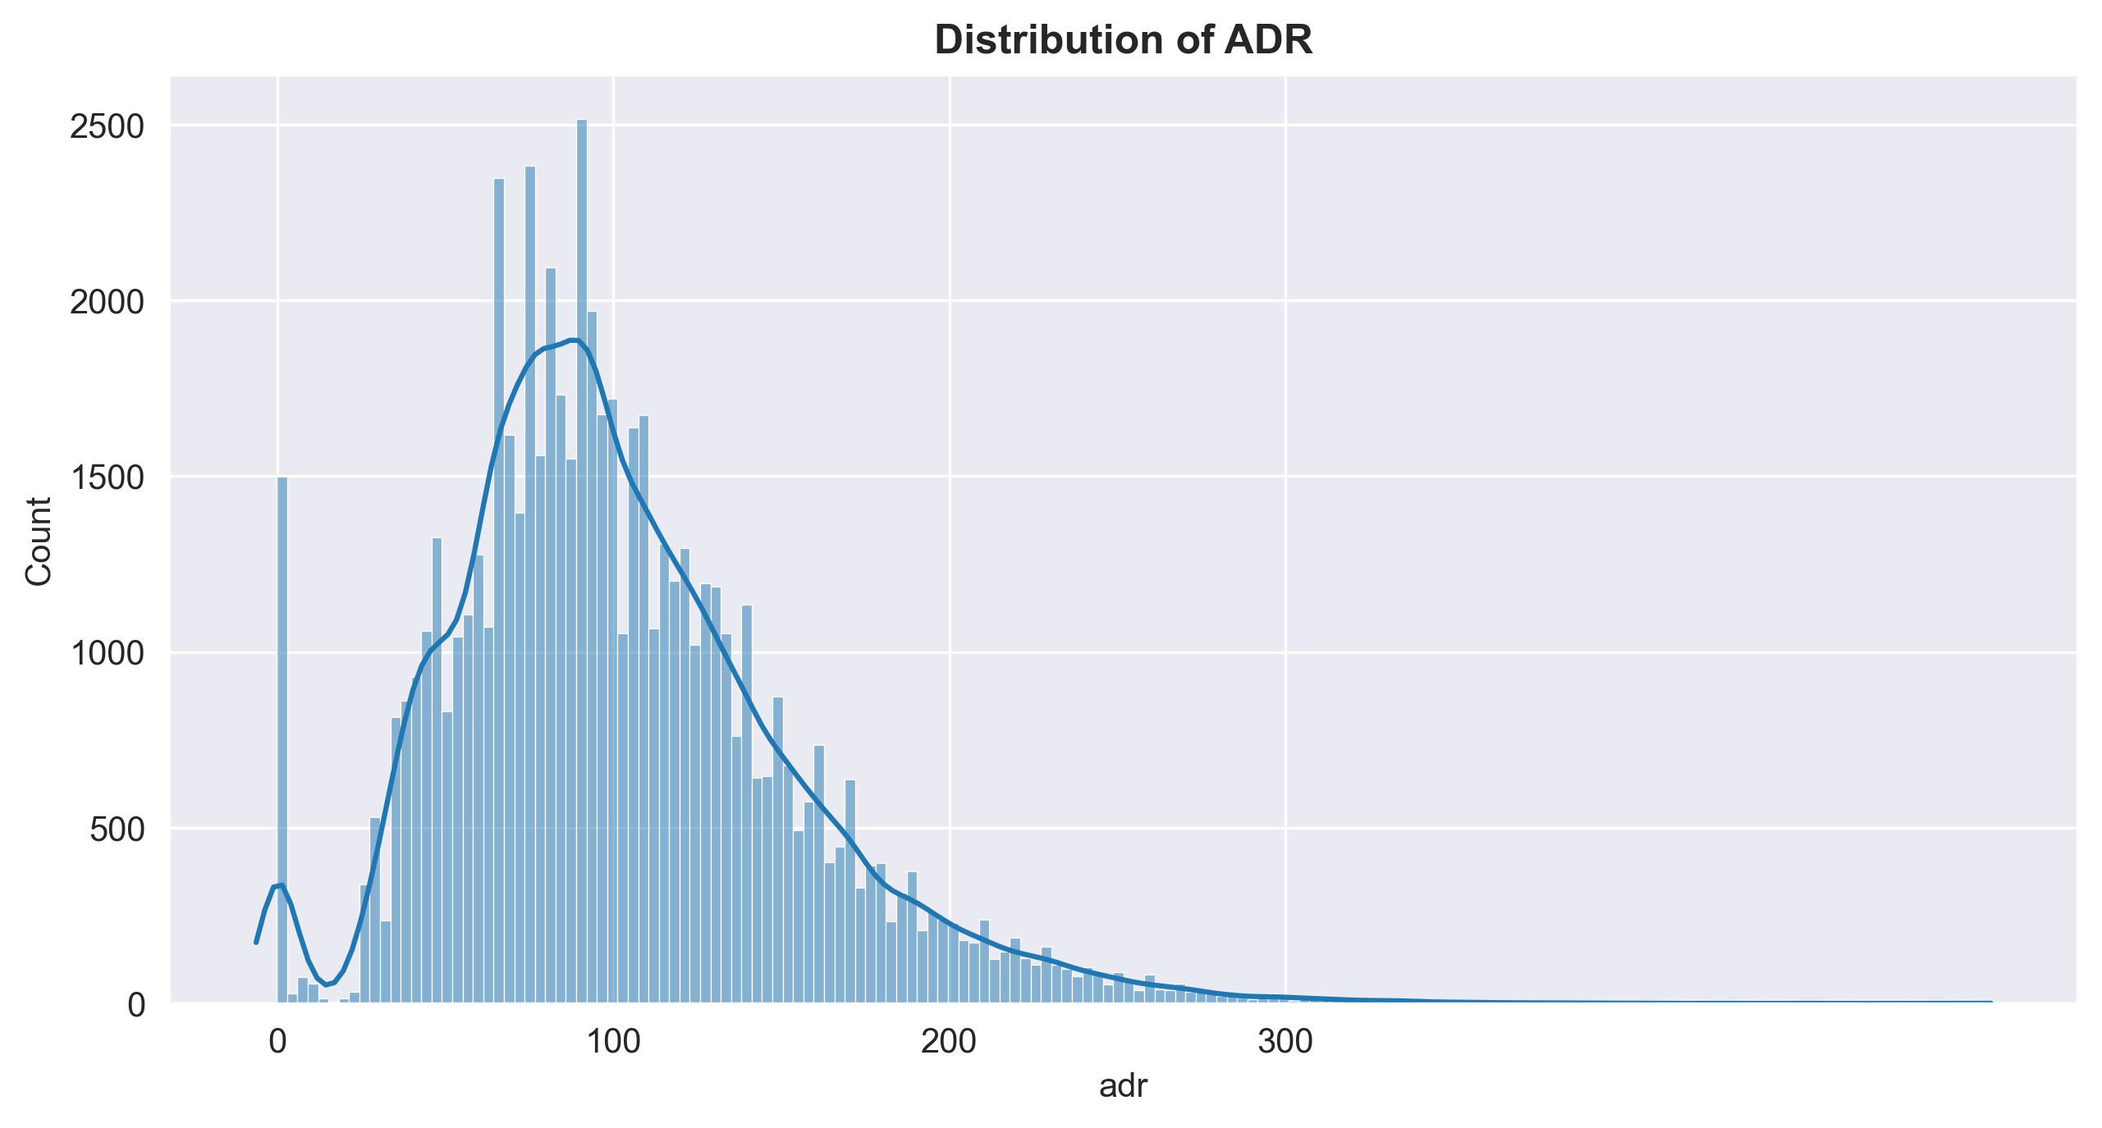
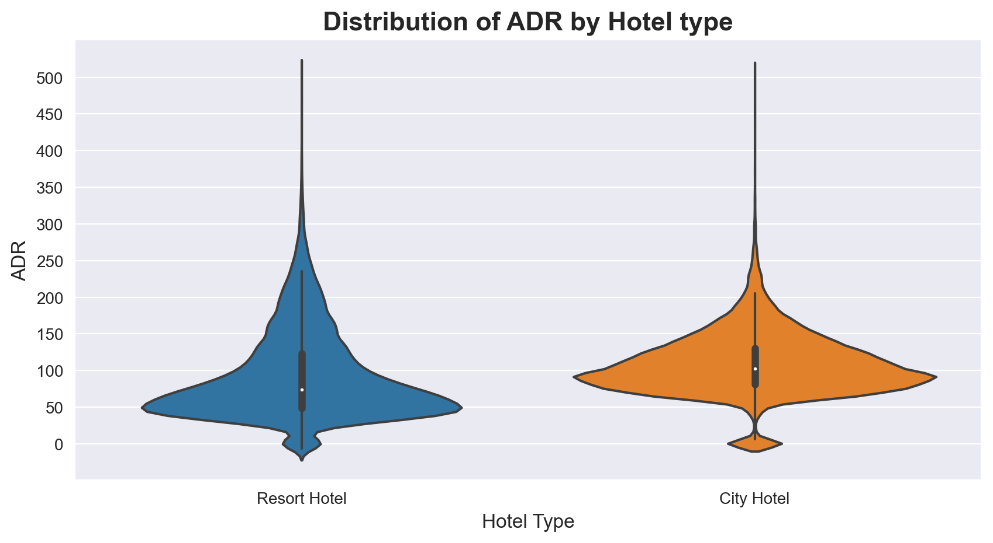
ADR Distribution
The overall distribution of Average Daily Rate (ADR) reveals that the majority of customers pay within the range of 80 to 120. Upon analyzing the ADR distribution separately for the resort hotel and city hotel:
Most guests in the resort hotel pay around 50 as ADR.
Most guests in the city hotel pay around 100 as ADR.

Slide 32
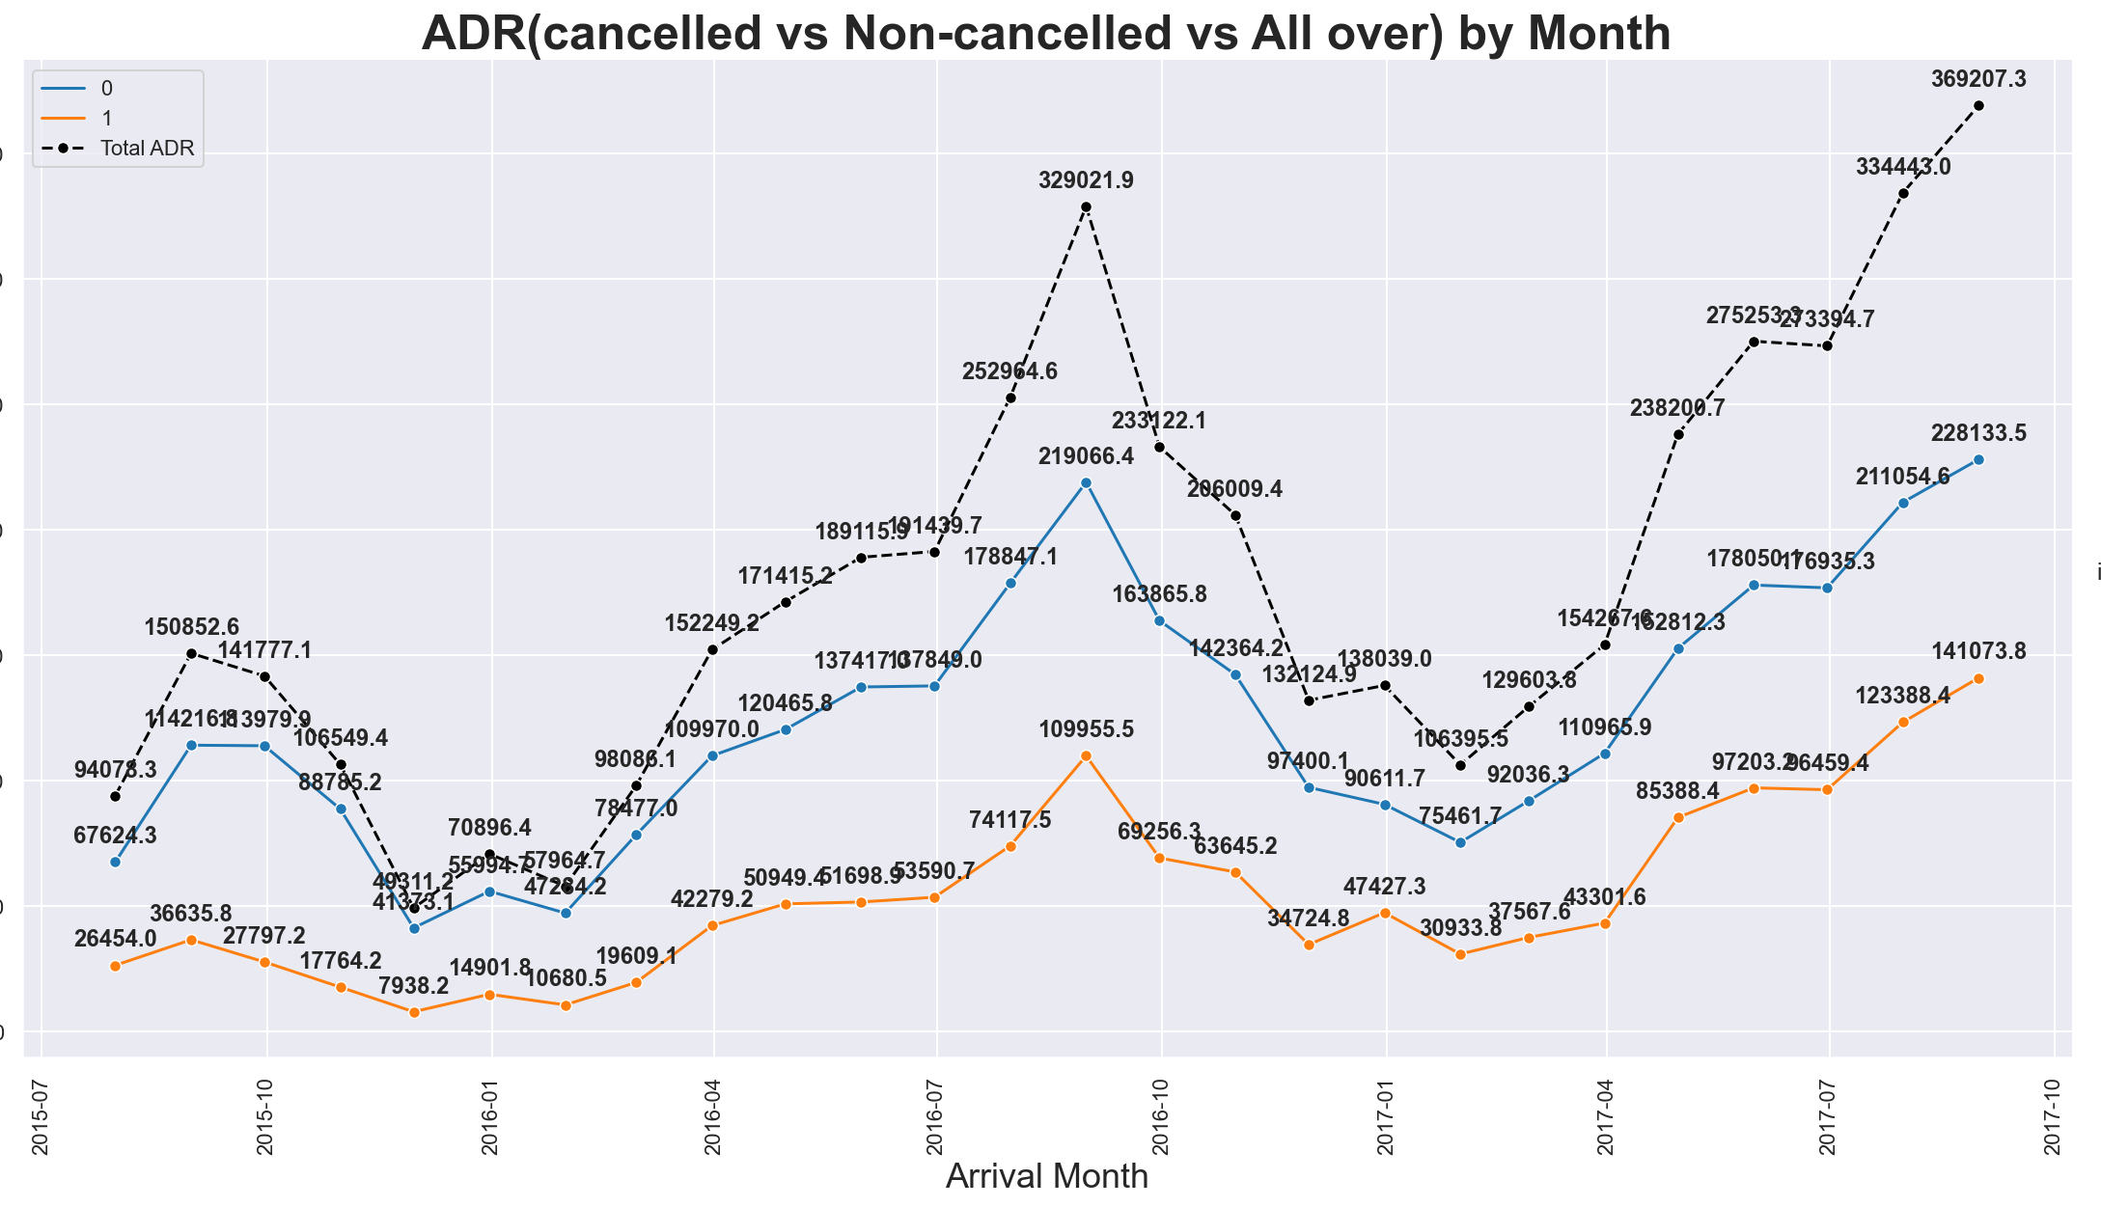
Monthly ADR Potential
The plot shows the total mean potential ADR per month.
The black dotted line represents the potential ADR without cancellations.
The blue line indicates the mean ADR of successful bookings,
while the orange line represents the mean ADR lost due to cancellations.

Slide 33
Correlation
There is no such strong correlation between the variables but moderate correlation can be seen with some variables which we already discussed before.

Slide 34
Conclusion
City Hotel has more number of bookings.
Around 27.5% of bookings were cancelled.
95 % guests are new .only 5% guests are repeated.
75% Bookings are came from Travel agent/Tour operator.
Almost 80% of the bookings are coming from the transient customer type.
Most customers prefer the BB (Bed and Breakfast) meal type category, and the majority opt for the no deposit option.
Most bookings come from Europe, with Portugal, England, and France being the top three countries.
Both hotels experience significant cancellations for bookings with a lead time greater than 30 days. However, the most successful bookings are those made within a 7-day timeframe.
July, August, and September exhibiting higher bookings over the three years. These months also have a mean lead time of 2-3 months, indicating peak demand.
weekday bookings higher than weekend bookings, with Mondays having the highest number of bookings. This suggests a higher proportion of customers on business trips.
At city hotels, the average stay duration is typically around 2-3 days. However, at resort hotels, with most guests staying for 7 days. Notably, a significant number of bookings at the resort hotel can be seen for which length of stay extends up to 14 days.
Despite the city hotel having more bookings, the resort hotel generates higher revenue during peak demand months, indicating its superior revenue generation capability.
The weekly average occupancy rate for both hotels consistently stayed below 60% over the three years.
The City Hotel experiences a higher rate of cancellations compared to the Resort Hotel.
The cancellation rate is higher for customers who have previously cancelled their bookings.
The choice of deposit type, whether Non-Refundable or No Deposit, does not have a significant impact on the occurrence of cancellations.
The Corporate segment has the highest successful booking rate, followed by Direct bookings and offline Travel Agent/Tour Operator bookings. Surprisingly, the Online Travel Agent (TA) segment has the lowest successful booking rate despite having the highest number of bookings.
Booking changes and receiving a different room do not significantly contribute to the cancellation of bookings.
The majority of customers across both hotels pay an ADR between 80 to 120 . Specifically, guests at the resort hotel tend to pay around 50, while guests at the city hotel typically pay around 100 as their ADR.

Slide 35
Recommendations
Cancellation Analysis :- We should communicate with guests, offering flexible cancellation policies, and providing incentives for non-refundable bookings.
Customer Retention :- Focus on enhancing guest loyalty by implementing a comprehensive guest retention program. Offer personalized promotions, exclusive benefits, and rewards to encourage repeat bookings and foster long-term relationships with customers.
Travel Agent/Tour Operator Partnership :- Strengthen collaborations with travel agents and tour operators through targeted marketing campaigns, joint promotions, and enhanced commission structures. Provide training and resources to help agents promote your properties effectively.
Transient Customer Analysis: Understand the preferences and needs of transient customers to tailor marketing campaigns and improve the overall customer experience. Offer personalized recommendations, provide relevant information, and highlight unique features that appeal to this customer segment.
Lead Time Optimization :- Encourage early bookings by offering incentives such as discounted rates or exclusive offers for customers who book well in advance. Implement targeted marketing campaigns to highlight the benefits of early reservations and create a sense of urgency
Revenue Optimization :- Implement dynamic pricing strategies to maximize revenue during peak months. Adjust prices based on demand, offer value-added packages, and explore revenue management techniques to optimize revenue potential.
Occupancy Rate Improvement :- Identify strategies to increase occupancy rates, such as targeted marketing campaigns, partnerships with online travel agencies, and offering competitive rates during low-demand periods. Monitor market trends and adjust pricing and promotions accordingly.

